Slide 1
Deception Detection
Team 2 - Socratis, Maureen, Daniel, Tarekul, Miguel

Slide 2
Current Lie Detectors
Typical lie detectors used what are called contact receivers to analyze information like heart rate, skin conductivity, sweat response, and blood pressure.
The problem arises when physiological changes recorded are manipulated by the subject. Conscious physiological changes can be manipulated by the subject or the environment they are in can have an impact on their behavior.

Slide 3
Our ‘Solution’
Our Research aims on using non-invasive techniques and measuring subconscious physiological changes to accurately and efficiently indicate whether a subject is being truthful or lying.
Using multi-modal data like facial micro-expressions and voice analysis with machine learning techniques, we will attempt to produce a correlation between facial and vocal features that can accurately predict when someone, either intentionally or not, commits an act of deception

Slide 4
Voice
Vocal analysis has become a popular mode of data for deception detection. In conjunction with facial data, it can provide a higher prediction rate.
Four voice characteristics will be looked into. Vocal pitch, pitch amplitude, mean energy of utterance, and changes in fundamental frequency show the highest correlation to deception detection.

Slide 5
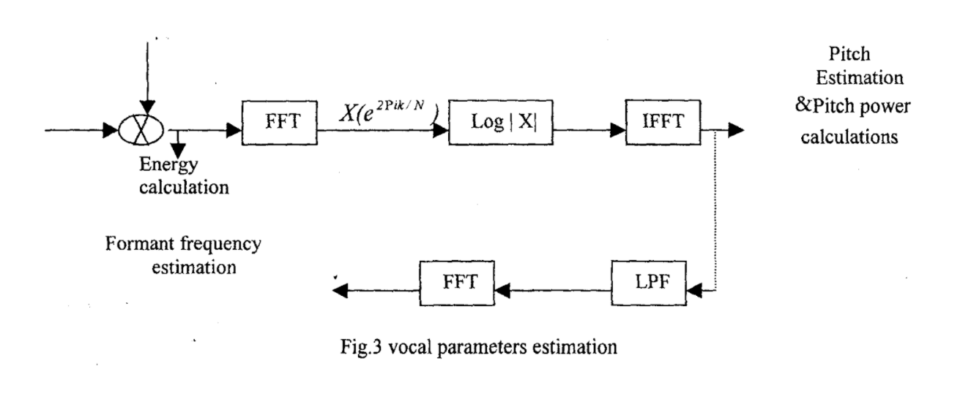
FSM that generalizes the process that we would recreate

Slide 6
Micro Facial Expressions
Facial Micro-Expressions are involuntary facial changes that are not discernable to the human eye (micro movement occurs in 1/25 of a second); they occur in short time interval, usually few milliseconds.
Micro-expressions are useful tools for detecting if a person is trying to hide something (or lying) because a combination of fear and surprise, anger and fear, or contempt and fear all register when a lie is told.

Slide 7
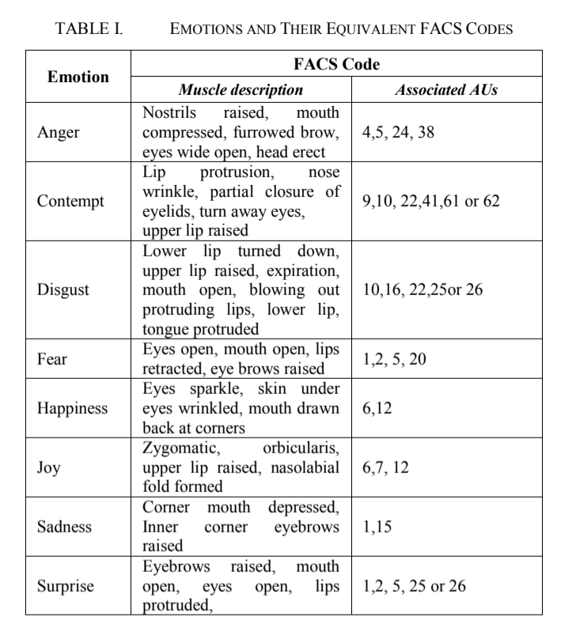
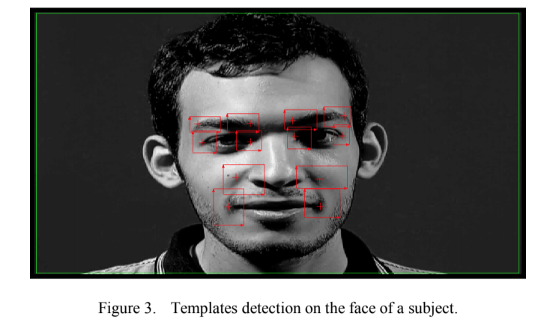
List of Micro Facial expressions

Slide 8
Eye Blink Patterns
Eye blinking rates decrease when there is an increase in the cognitive demand. Lying is more cognitively demanding than telling the truth.
If the subject is lying, there will be a major decrease in the blink rate during in the target period as compared to the threshold value for some time (during a lie), followed by a significant increase in the blink rate above the threshold value, once the lie has been told.
.

Slide 9
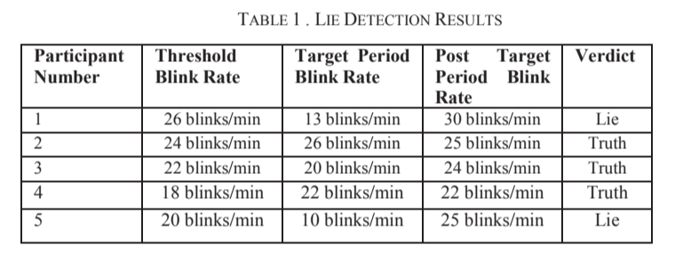
Table results for Blink rate during lie

Slide 10
Anticipated Issues
General Audio Visual Issues
Lighting
Camera Quality
Subject’s head orientation
Background Noise
Creating a circumstance where the subject will provide usable data

Slide 11
Conclusion
Our goal is to accurately and efficiently determine whether a person is deceiving during a conversation. To do so, we have come up with an audio-visual system to monitor physiological changes. We choose to monitor subconscious behavior and we keep our technique of capturing data, non-invasive.
We anticipate that we’ll face the general issues involved with audiovisual systems.
These include background noise, poor lighting, out of focus video, and subject’s poor head orientation.
We aim to avoid these environmental conditions by recording in an enclosed environment, use a high speed camera in a well lit room, and have subject face directly as the camera. (Camera will be hidden)

Slide 12
Technologies To Be Used
Mostly Python
Google suite of AI tools and Cloud Environment. Preview
TensorFlow
Software Signalling (LPF, HPF, FFT, IFFT)

